Slide 1
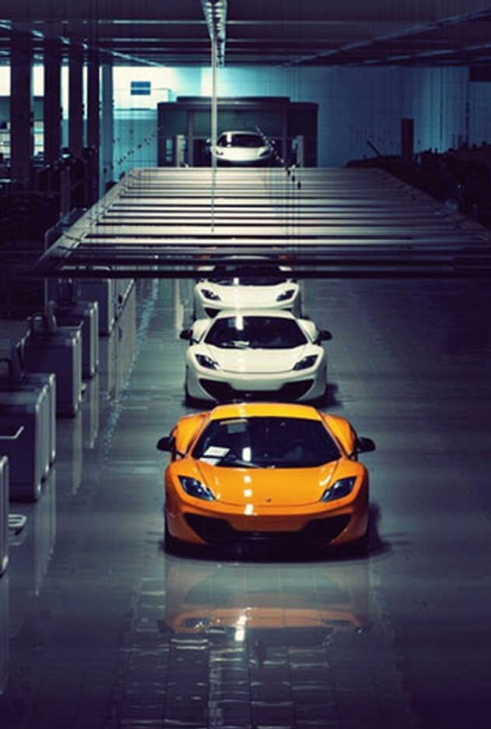
Vehicle Recognition and Classification

Slide 2

TABLE OF CONTENTS
01
02
03
04
05
06
Introduction
Benefits
Dataset
Models
Conclusion
Model
Performance

Slide 3
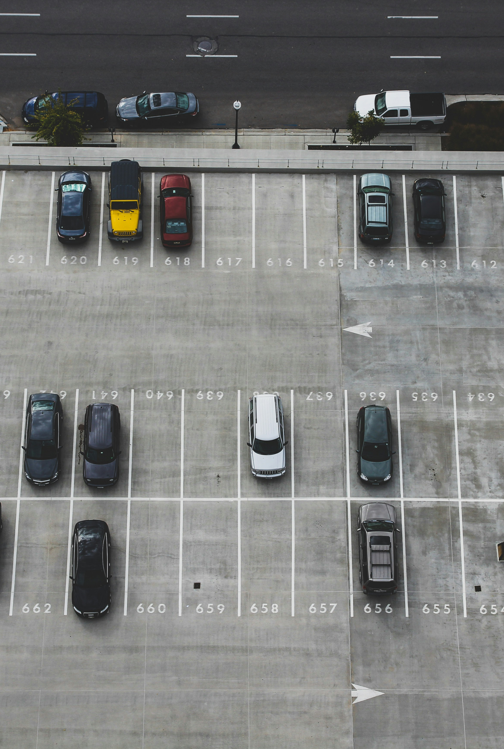
INTRODUCTION
In recent years, technology has transformed how we identify and classify vehicles, revolutionizing road safety, traffic management, and security measures. Through machine learning and deep learning, researchers have made significant strides in accurately detecting and categorizing vehicles in diverse environments. This presentation explores different machine learning models and compares their performances.

Slide 4
BENEFITS
Traffic
Safety
Automated
Parking
Surveillance
Frameworks
Theft
Recovery
Security
Systems

Slide 5
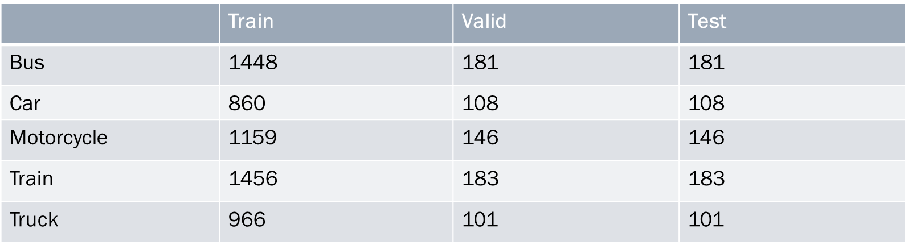
DATASET
The primary aim of this dataset is to facilitate precise object detection tasks, particularly in identifying and tracking vehicles within images. (https://www.kaggle.com/datasets/mrtontrnok/5-vehichles-for-multicategory-classification?resource=download)

Slide 6
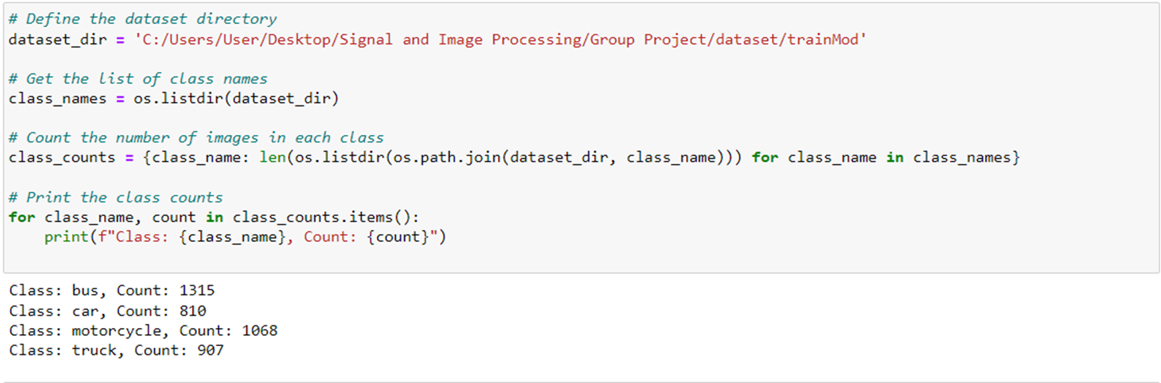
DATASET

Slide 7
MODELS
Convolutional Neural Network (CNN)
Yolov8
It is a type of artificial neural network that is specifically designed for processing and analysing visual data, such as images and videos. CNNs are widely used in computer vision tasks including image classification, object detection, image segmentation, and more.
YOLOv8 is an advanced version of the "You Only Look Once" (YOLO) series of object detection models, designed for fast and accurate real-time object detection. When used for car counting and classification, YOLOv8 will detect cars, count cars and classify cars. This model ensures the fastest possible inference time, making it well-suited for real-time use

Slide 8
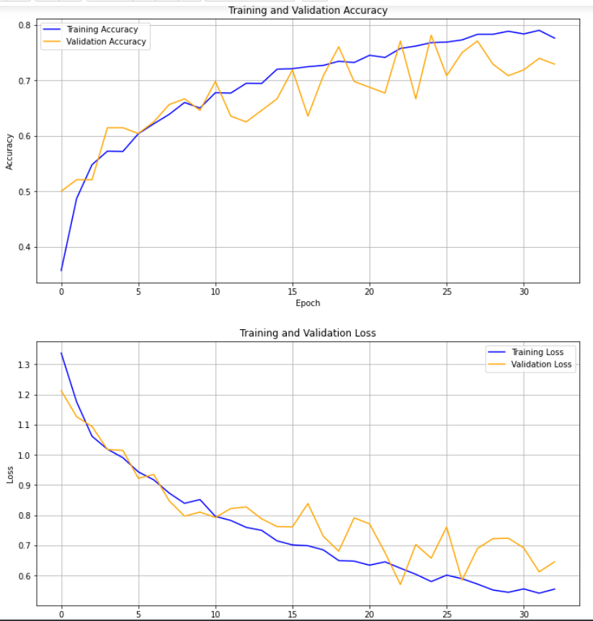
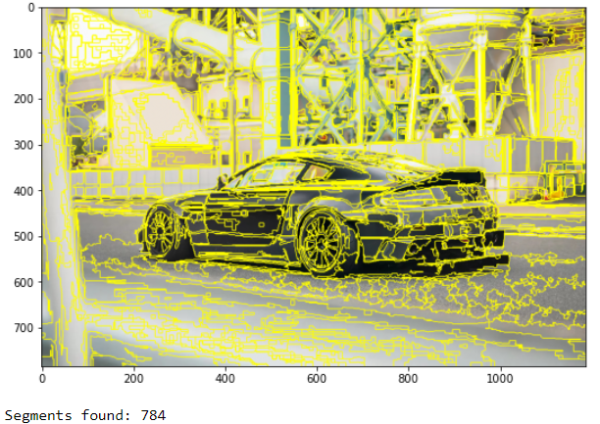
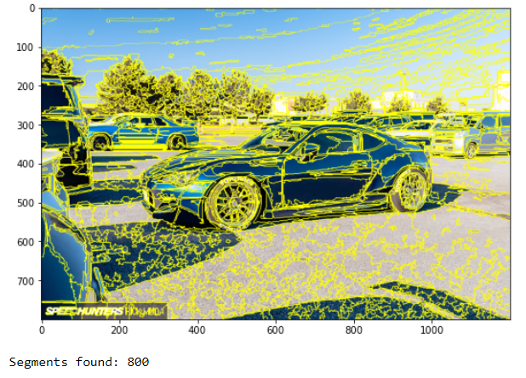
MODEL PERFORMANCE
CNN

Slide 9
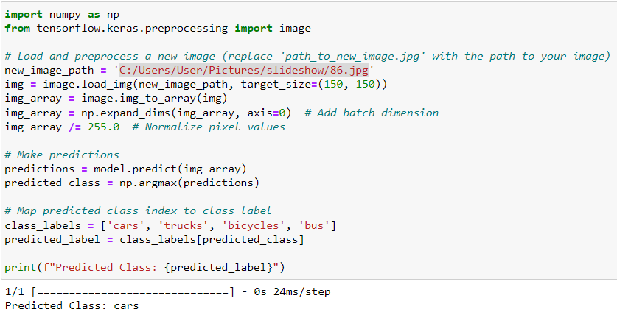
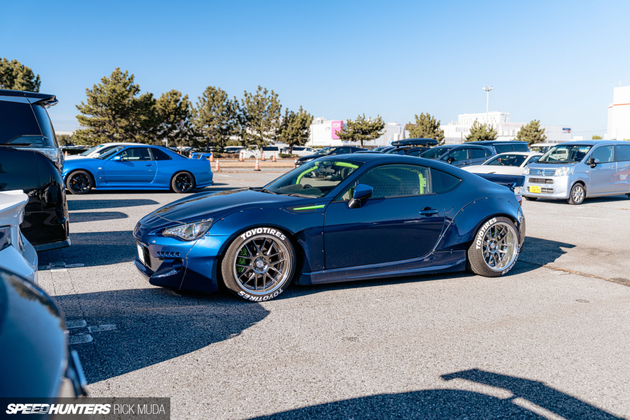
MODEL PERFORMANCE
CNN

Slide 10
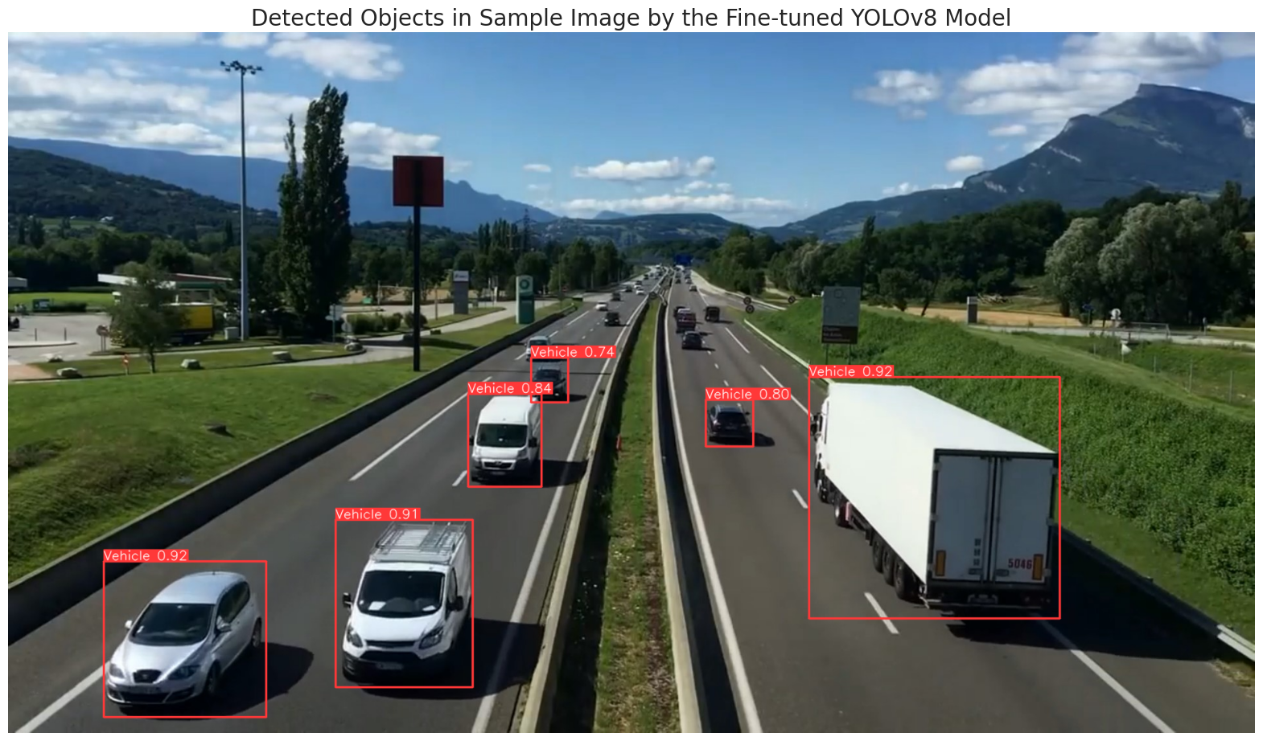
MODEL PERFORMANCE
Yolov8

Slide 11
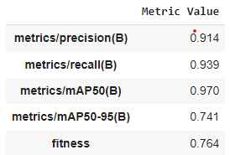
MODEL PERFORMANCE
Yolov8

Slide 12
MODEL PERFORMANCE
Models | Accuracy | Precision | Recall
RCNN [Berwo et al., 2023] | 66% | 70% | 68,44%
KNN [Niroomand et al., 2021] | 74% | - | -
AlexNet [Habib et al., 2021] | 80,3% | - | -
CNN [proposed model] | 80% | 41% | 50%
Yolov8 [proposed model] | 91% | 91,4% | 93,9%

Slide 13
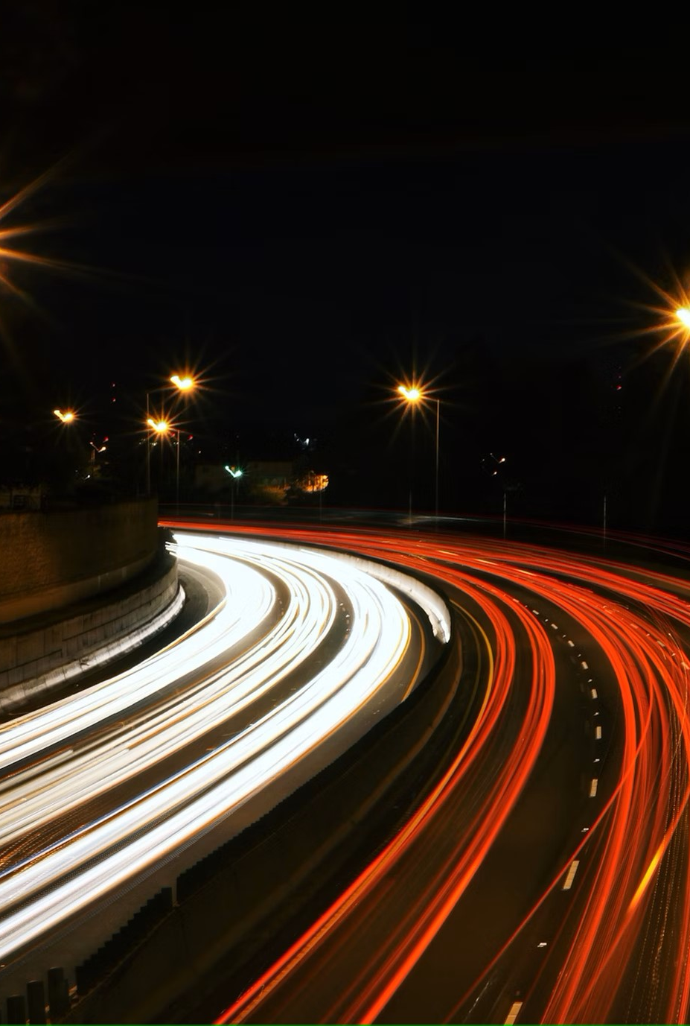
CONCLUSION
In conclusion to the models and their outcomes:
The dataset that has been used for CNN could explain some of the CNN deficiencies.
The description of every vehicle type needs to be clearly defined when creating a dataset.
The standard CNN model we built is better than the fast RCNN model built in a past article.

